Slide 1
Data Visualization
Fall 2018
Imani Palmer

Slide 2
Github: https://github.com/inp2/Data-Viz-Fall2018
Classroom: https://classroom.github.com/classrooms/41658328-lis-590-data-visualization-fall-2018
Slack: datavizuiucfall2018.slack.com

Slide 3
Schedule
Week 1 (Aug 27th - Aug 31st): Introduction, syllabus, examples of visualization, and installation of packages (jupyter notebook, & python)
Week 2 (Sept 3rd - Sept 7th): Dealing with Data
Week 3 (Sept 10th - Sept 11th): Basic Principles of Data Visualization
Week 4 (Sept 17th - Sept 21st): Simple Plotting: Quantitative Plots
Week 5 (Sept 24th - Sept 28th): Binning Filtering, Smoothing, Multiplots, Histograms, & Distributions
Week 6 (Oct 1st - Oct 5th): Images: color theory, colormaps, generating visualizations of images and image-like quantities

Slide 4
Week 7 (Oct 8th - Oct 12th): Geospatial visualizations
Week 8 (Oct 15th - Oct 19th): Synthesizing multiple datasets
Week 9 (Oct 22nd - Oct 26th): Software ecosystem around visualization
Week 10 (Oct 29th - Nov 2nd): Network visualization
Week 11 (Nov 5th - Nov 9th): Statistical visualization
Week 12 (Nov 12th - Nov 16th): Interactive visualizations
Week 13 (Nov 19th - Nov 23rd): Thanksgiving Break
Week 14: (Nov 26th - Nov 30th): Advanced visualizations
Week 15: (Dec 4th - Dec 7th): Group presentations

Slide 5
Overview
What are the components of an effective visualization of quantitative data?
What tools and ecosystems are available for visualizing data?
What systems can be put in place to generate visualizations rapidly and with high-fidelity representation?

Slide 6
Overview
Students will be able to communicate information and data through visual representation
Students will be able to examine a visualization and understand how it can be improved upon
Students will have facility with the commonplace tools used for visualization, and a deeper understanding of where those tools have shortcomings

Slide 7
Grading
Assignments worth 60%
Final project worth 40%

Slide 8
Visualizations
Notes:
Religious identity across Greater London

Slide 9
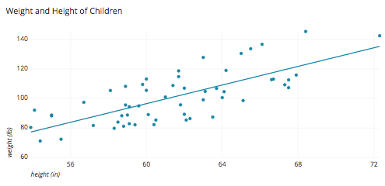
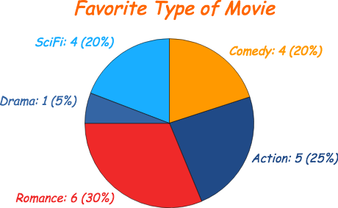
Pie Chart
Scatter Plot

Slide 10
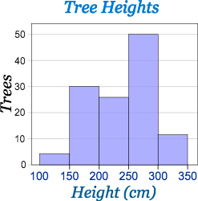
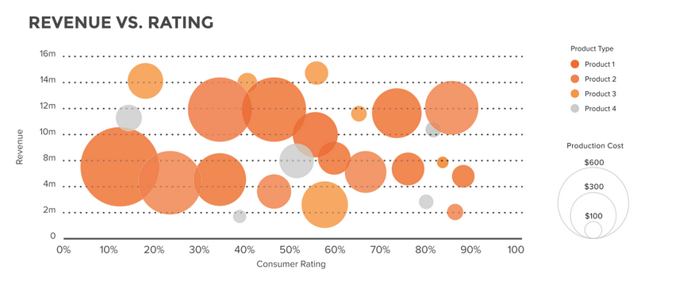
Bubble Chart
Histogram

Slide 11
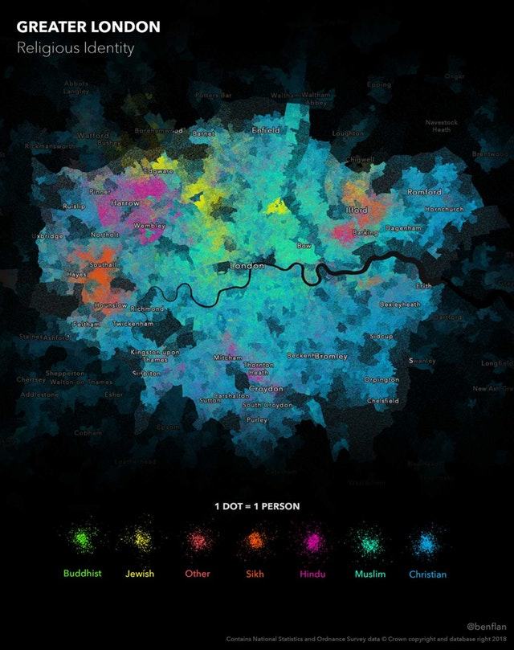
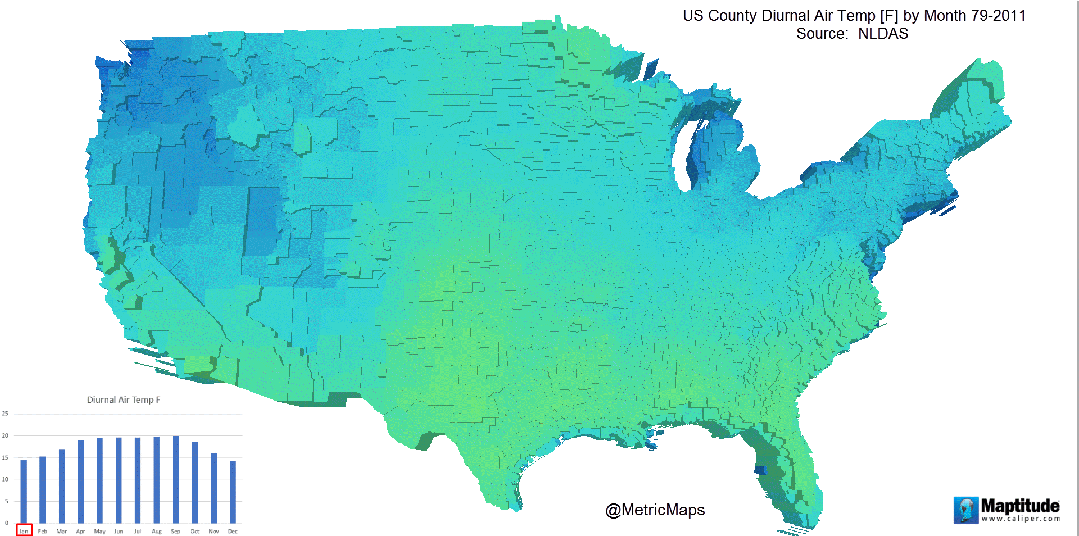
Notes:
Religious identity across Greater London
US County Diurnal Air Temperature by Month

Slide 12
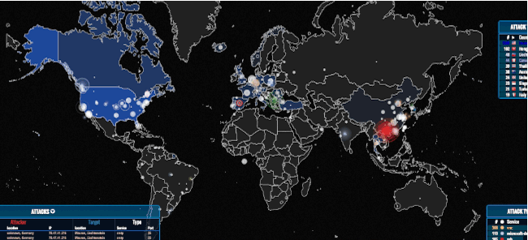

Slide 13
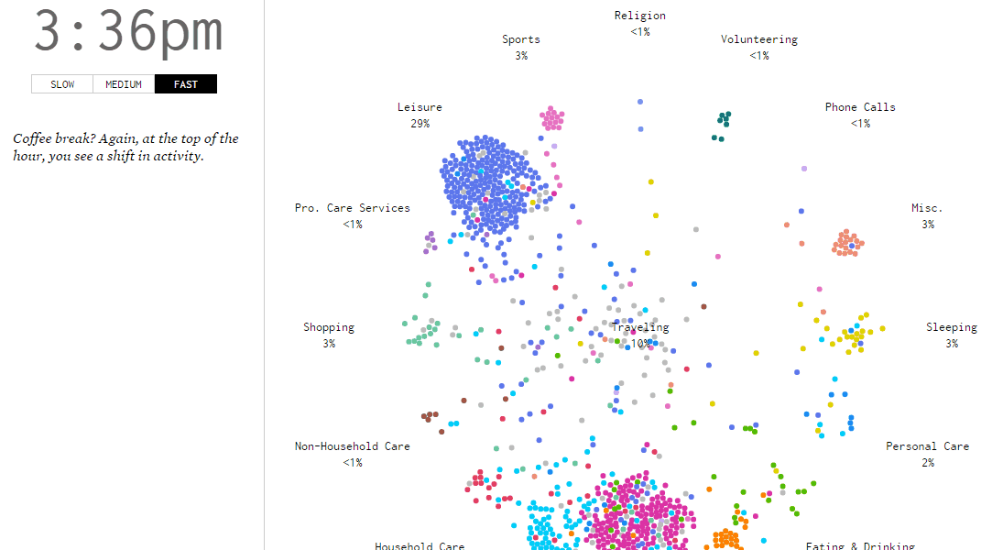

Slide 14
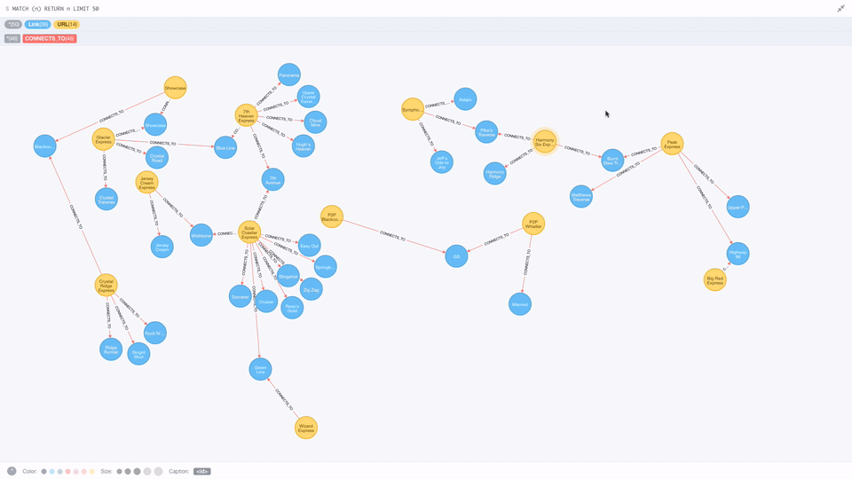

Slide 15
Visualize Data Jeopardy

Slide 16
Introduction to Github & Github Classroom
Github Classroom:
https://classroom.github.com/classrooms/41658328-lis-590-data-visualization-fall-2018
Signing up for Github Classroom
Sign up for a Github account if you do not already have one
Tutorial for those new to github
https://guides.github.com/activities/hello-world/

Slide 17
Introduction to Python and/or R
Install Python and/or R
Tutorials
https://www.codecademy.com/learn/learn-python
https://onlinecourses.science.psu.edu/statprogram/tutorials/statistical-software/r
Write your first program using python and/or R

Slide 18
Homework Assignment 0
Submit a computer program (any program) to Github Classroom
Due date on Github Classroom

